Slide 1

Corona Virus Analysis
SQL
Aml Yasser

Slide 2
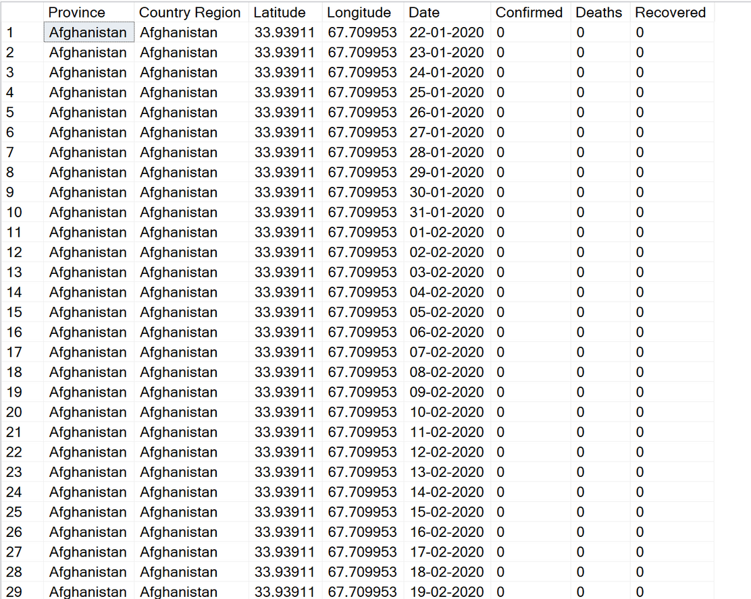
Sneak Peek on the data

Slide 3
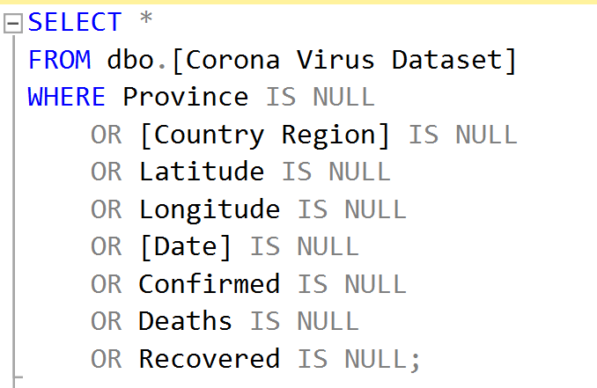
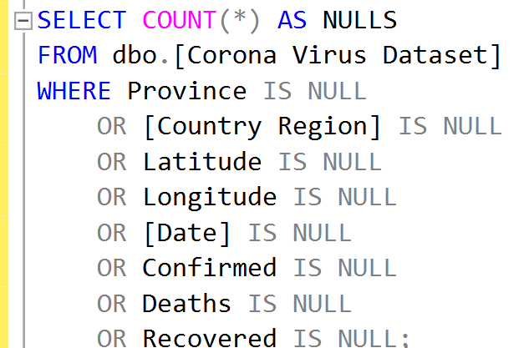
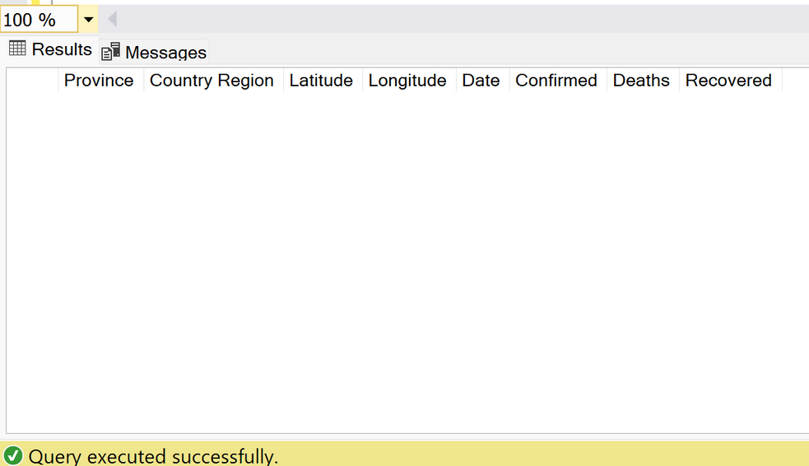
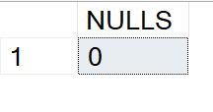
Q1. Write a code to check NULL values

Slide 4
Q2. If NULL values are present, update them with zeros
for all columns.

Slide 5
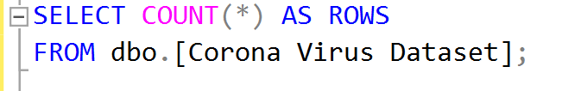
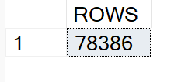
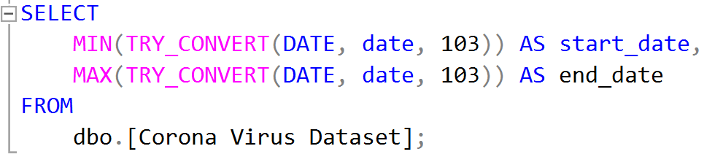
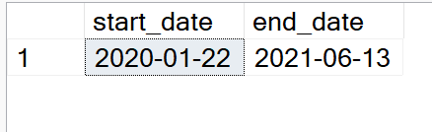
Q3. check total number of rows
Q4. Check what is start_date and end_date

Slide 6

Q3. check total number of rows
Q4. Check what is start_date and end_date

Slide 7
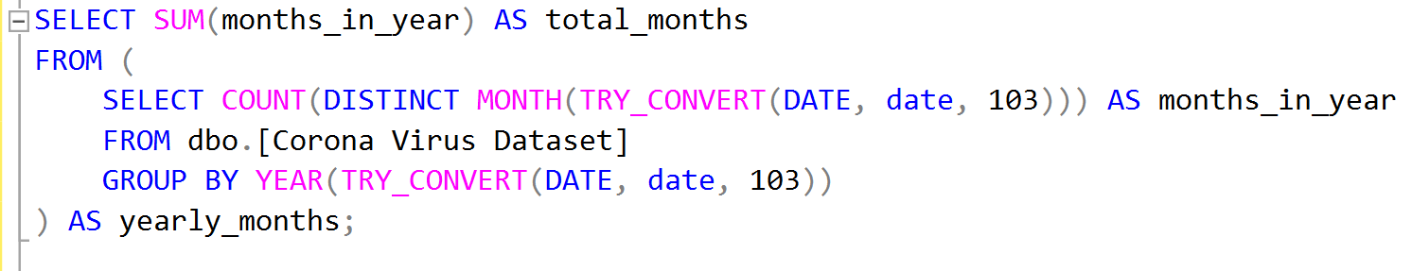
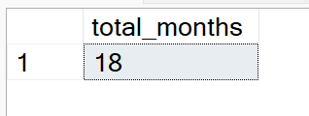
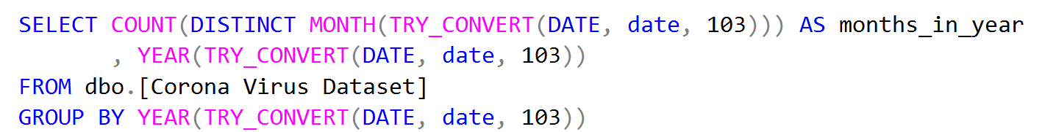
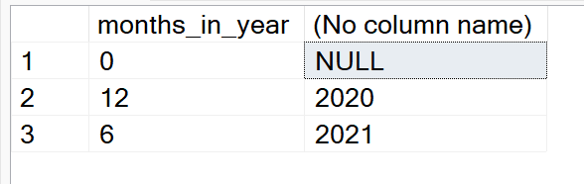
Q5. Number of months present in dataset

Slide 8
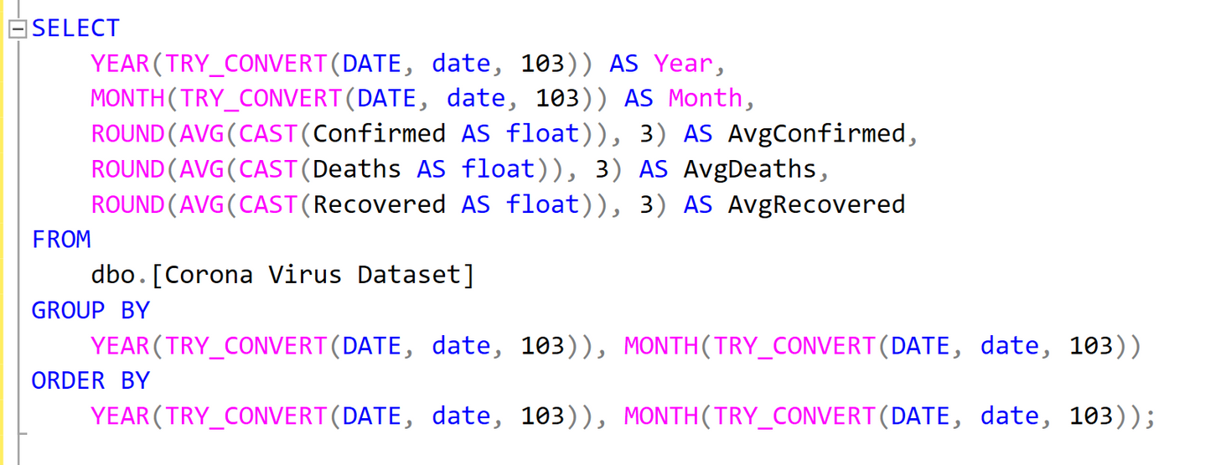
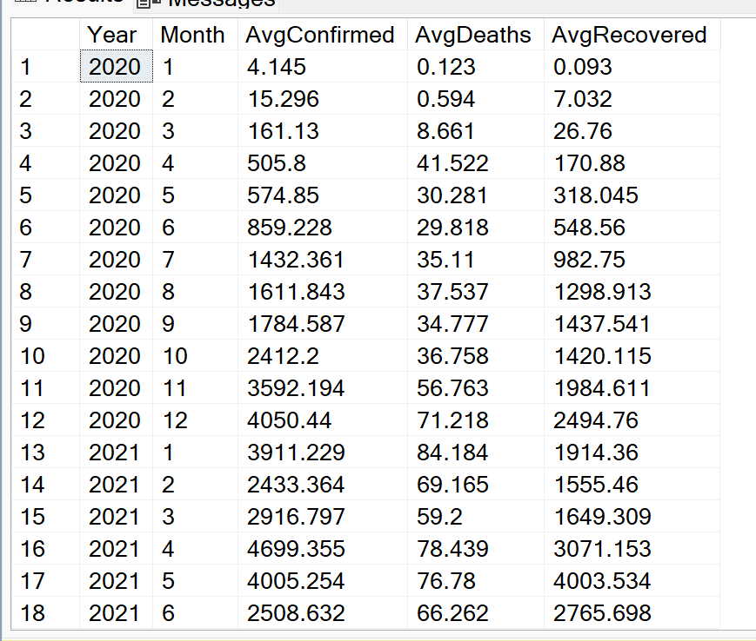
Q6. Find monthly average for confirmed, deaths, recovered

Slide 9
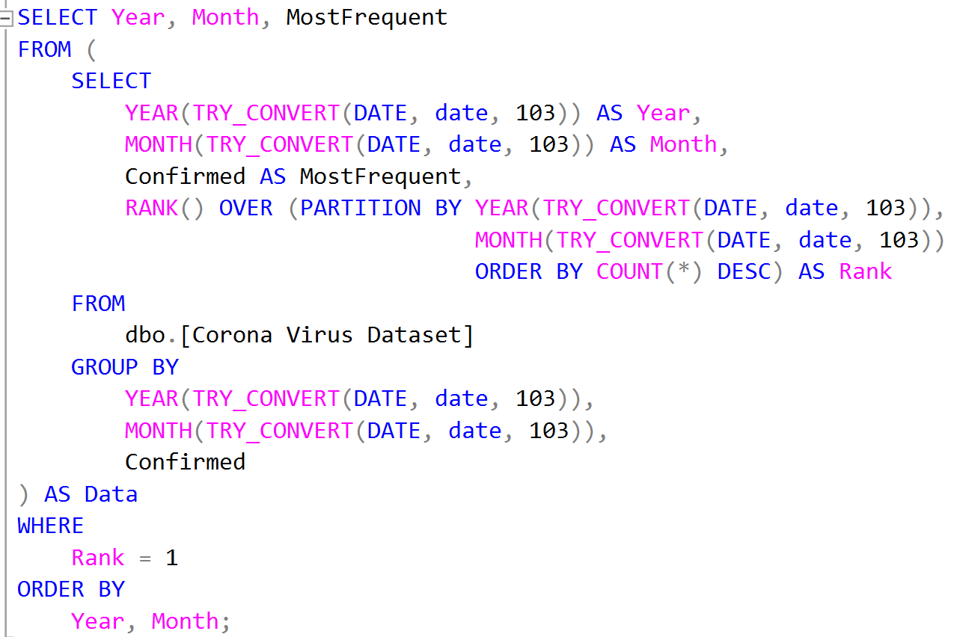
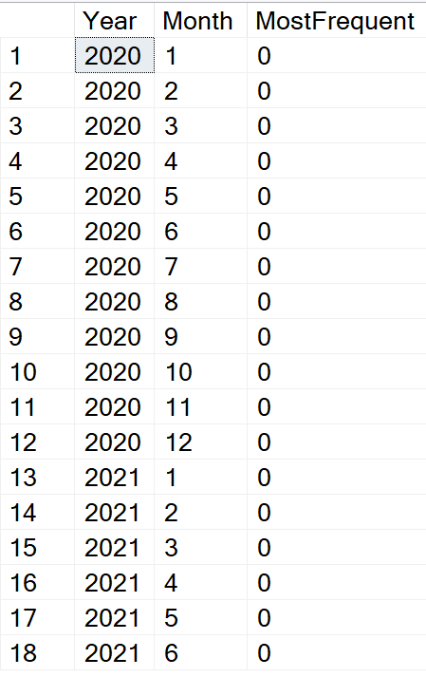
Q7. Find most frequent value for confirmed, deaths, recovered
each month

Slide 10
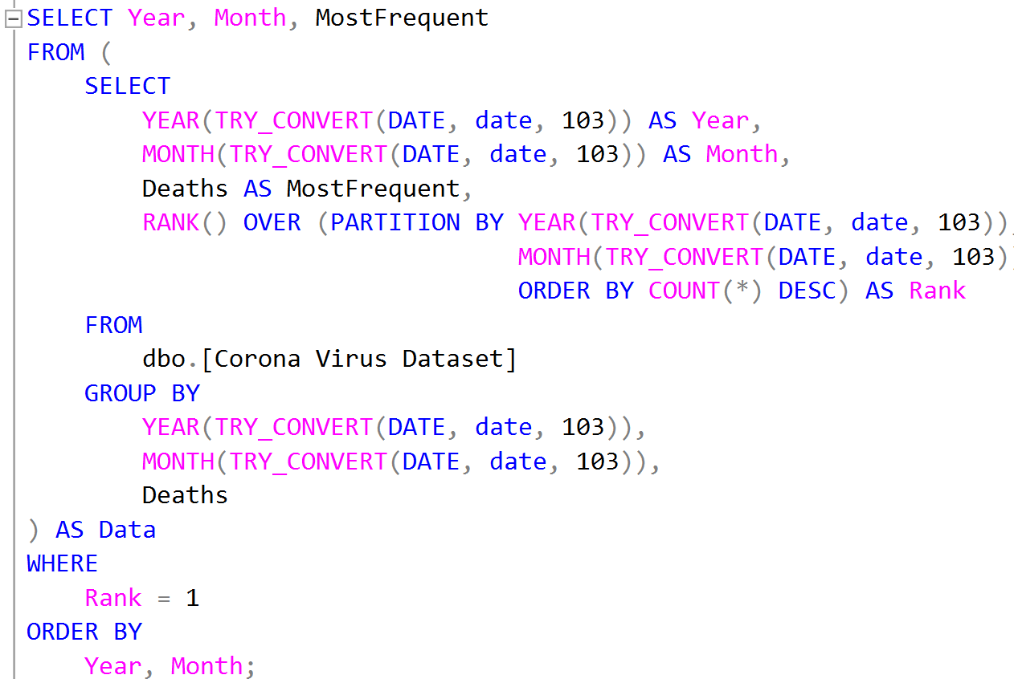
Q7. Find most frequent value for confirmed, deaths, recovered
each month

Slide 11
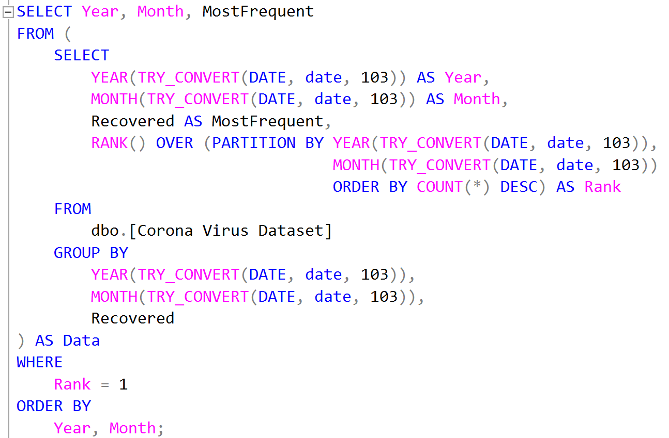
Q7. Find most frequent value for confirmed, deaths, recovered
each month

Slide 12
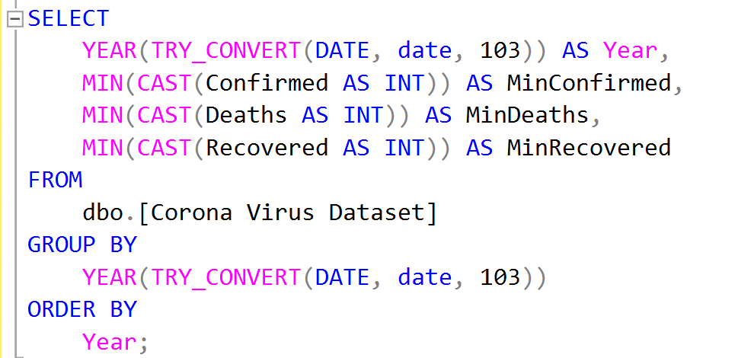
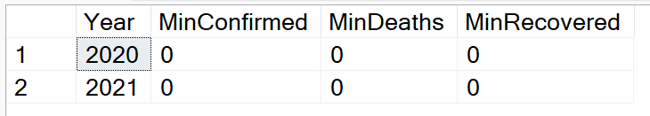
Q8. Find minimum values for confirmed, deaths, recovered
per year

Slide 13
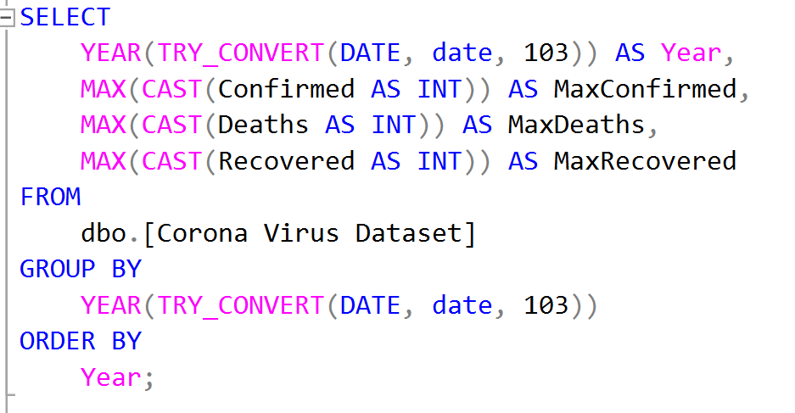
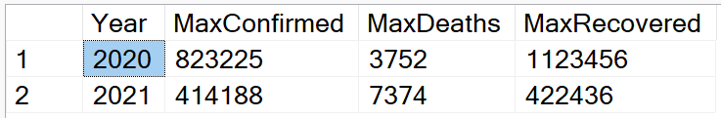
Q9. Find maximum values of confirmed, deaths, recovered
per year

Slide 14
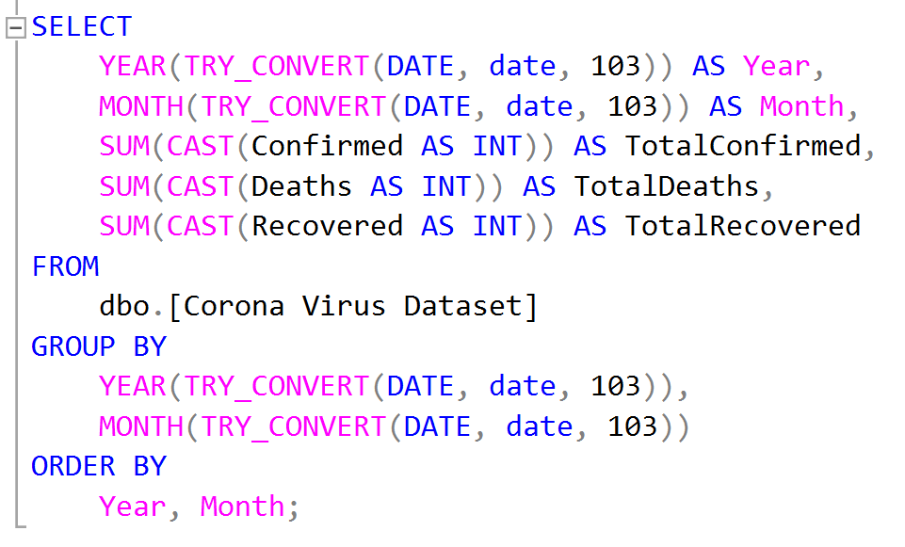
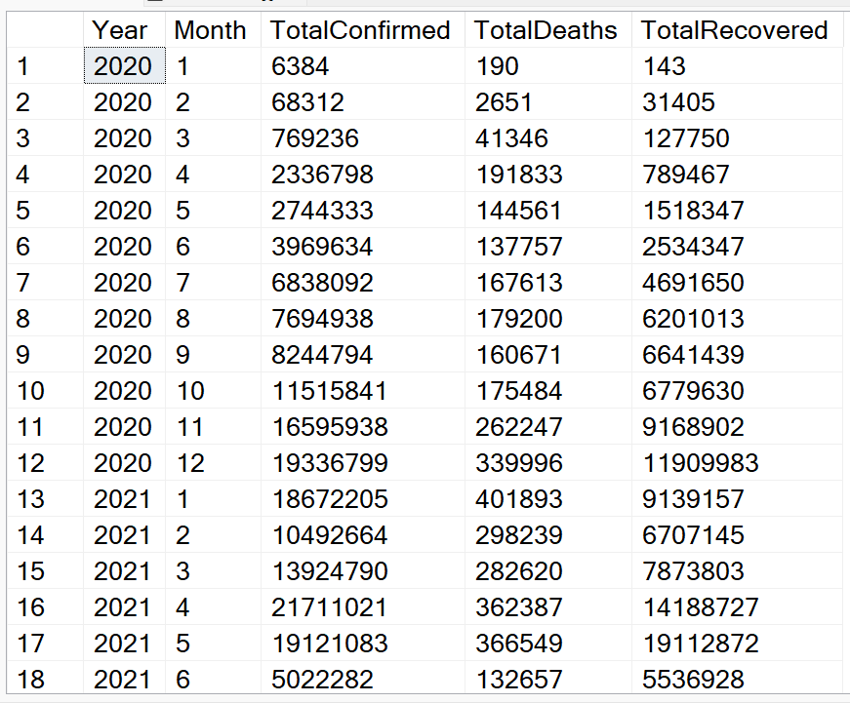
Q10. The total number of case of confirmed, deaths, recovered
each month

Slide 15
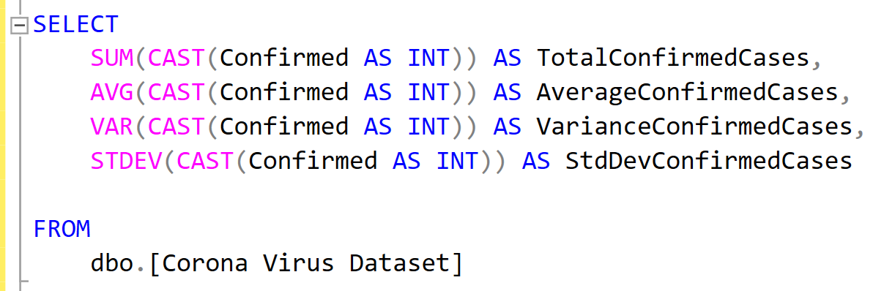
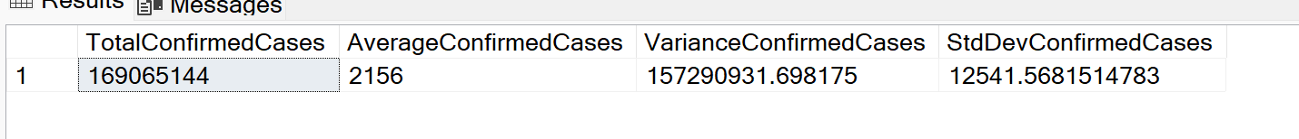
Q11. Check how corona virus spread out with respect to
confirmed case
(Example: total confirmed cases, their average, variance & STDEV )

Slide 16
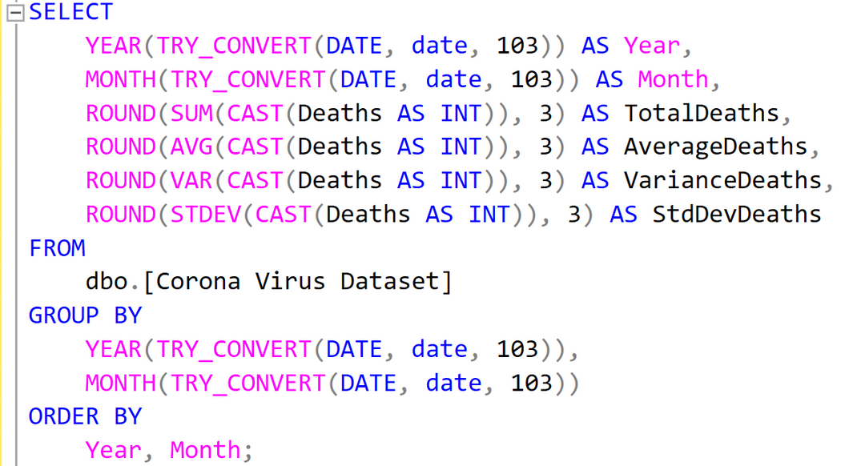
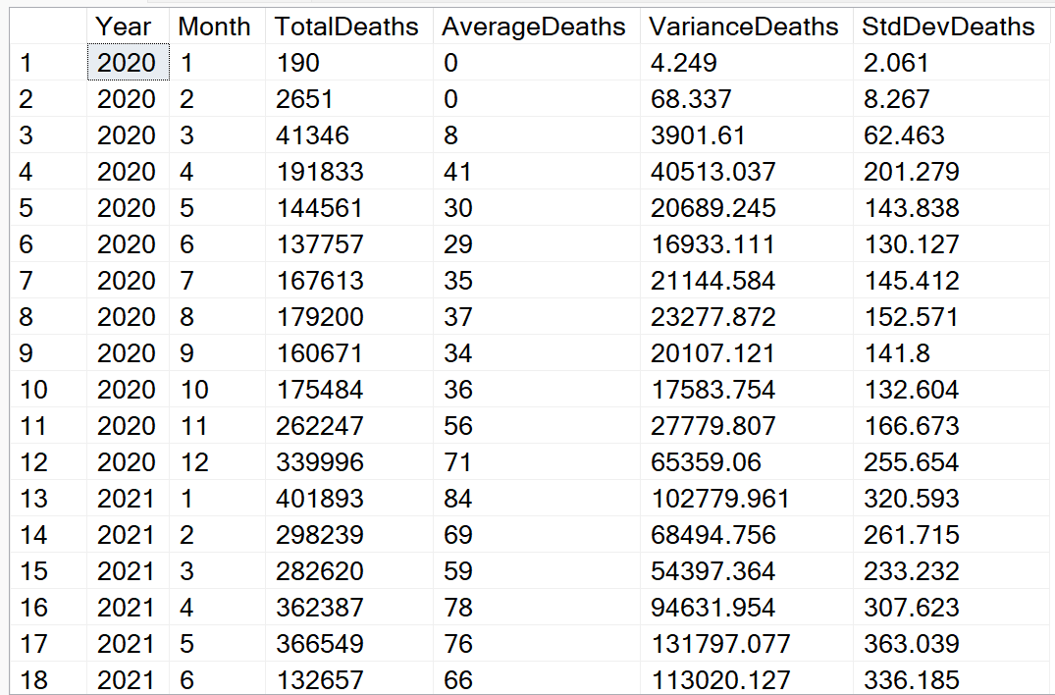
Q12. Check how corona virus spread out with respect to
death case per month
(Example: total death cases, their average, variance & STDEV )

Slide 17
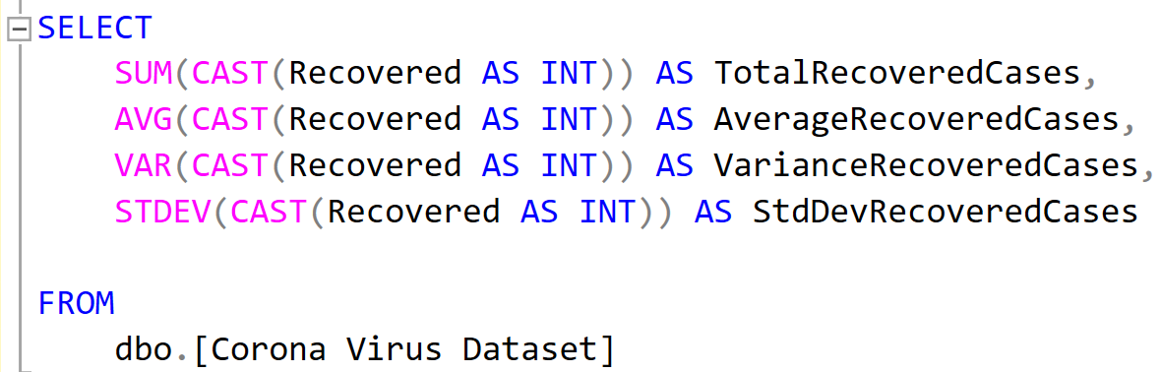
Q13. Check how corona virus spread out with respect to
recovered case
(Example: total recovered cases, their average, variance & STDEV )

Slide 18
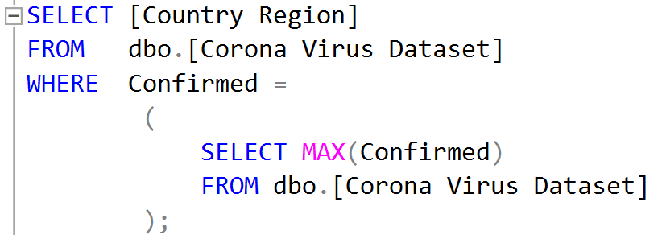
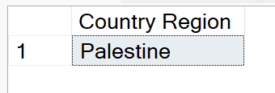
Q14. Find Country having highest number of the Confirmed case

Slide 19
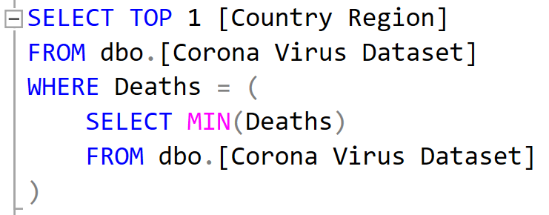
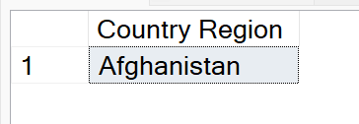
Q15. Find Country having lowest number of the death case

Slide 20
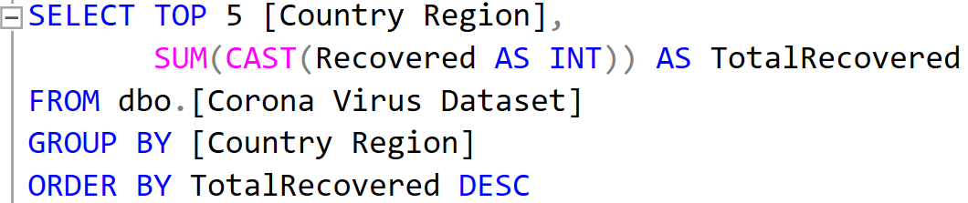
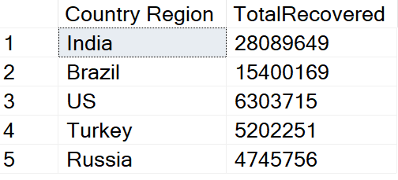
Q16. Find top 5 countries having highest recovered case

